Slide 1
CAPSTONE PROJECT
ADULT MORTALITY RATE ANALYSIS
Presented By:
1. DEEPATHARASAN R A -Alagappa college of technology,Chennai- CERAMIC DEPARTMENT

Slide 2
OUTLINE
Problem Statement
Proposed System/Solution
System Development Approach
Algorithm & Deployment
Result
Conclusion
Future Scope
References

Slide 3
PROBLEM STATEMENT
Problem statement: Analyze average crude mortality rate in individuals.
Objective: Investigate the leading causes of adult mortality and their prevalence across different populations.
Scope: The analysis will encompass global trends in adult mortality rates.
Methodology: Collect, analyze, visualize data, and provide recommendations.
Outcome: Insights into the determinants contributing to variations in adult mortality rates, including healthcare access, socioeconomic status, and lifestyle factors.

Slide 4
PROPOSED SOLUTION
The proposed solution for the adult mortality rate analysis project entails comprehensive data collection and analysis to identify trends, causes, and determinants of mortality disparities. By investigating leading causes of death and factors such as healthcare access and lifestyle choices, evidence-based interventions and policy recommendations can be formulated. Implementation efforts will focus on collaborating with stakeholders, monitoring effectiveness, and raising public awareness through education and community engagement. Through these strategies, we aim to reduce adult mortality rates, address disparities, and improve population health outcomes globally.

Slide 5
SYSTEM APPROACH
Building the proposed solution would involve a combination of data processing, feature engineering, and machine learning. Here are the key system and library requirements:
System Requirements:
Hardware:
A computer with sufficient processing power, preferably with multiple cores or a GPU for faster training of machine learning models.- Adequate RAM to handle the size of the dataset and computational requirements.
Software:-
An operating system compatible with the required machine learning libraries (e.g., Windows, Linux, macOS).

Slide 6
Library Requirements:
1.Data Processing and Analysis:-
Pandas: For data manipulation and analysis
NumPy: For numerical operations on data.
2. Data Visualization:-
Matplotlib and Seaborn: For creating visualizations to understand data patterns.
Plotly or Bokeh: Interactive visualization libraries for more complex visualizations.

Slide 7
ALGORITHM & DEPLOYMENT
Algorithm:
Sure, here's a brief overview:
1.Data Collection: Collect data on adult mortality rates, demographic factors, healthcare access.
2. Trend Analysis: Use statistical methods to analyze temporal trends in adult mortality rates.
3. Feature Engineering: Conduct cause-specific analysis to determine the leading causes of adult mortality.
4. Model Selection: Choose suitable machine learning models.
5. Training: Train the selected models using historical data.
6. Evaluation: Assess model performance using metrics.
7. Deployment: Deploy the trained model for real-time predictions.
8. Monitoring and Maintenance: Continuously monitor and update the model as needed.
.

Slide 8
Deployment Statement:
Deployment involves setting up the predictive model to make real-time predictions accessible to users. This can be done through:
1.Deployment Environment: Utilize a cloud-based deployment environment such as Amazon Web Services (AWS) or Microsoft Azure for scalability, accessibility, and security.
2. Integration with Existing Systems: Deploy algorithms for data collection, preprocessing, trend analysis, disparity identification, cause identification, and determinant analysis.
3. Cloud Deployment: Host the model on a cloud platform like AWS, Azure, or Google Cloud for scalability and accessibility.
4. Edge Deployment: Package the algorithms and associated code into modular components for easy deployment and maintenance.
5 User Interface: Develop a user-friendly interface for accessing predictions, visualizing results, and adjusting parameters if necessary.
6. Security and Compliance: Ensure that the deployment adheres to security standards and regulatory requirements, especially when dealing with sensitive data like adults mortality rates.
7. Scalability and Performance: Design the deployment architecture to handle varying levels of demand and ensure optimal performance under different load conditions.
By following this deployment statement, the mortality rate analysis system can be effectively deployed into production, providing stakeholders with timely insights

Slide 9
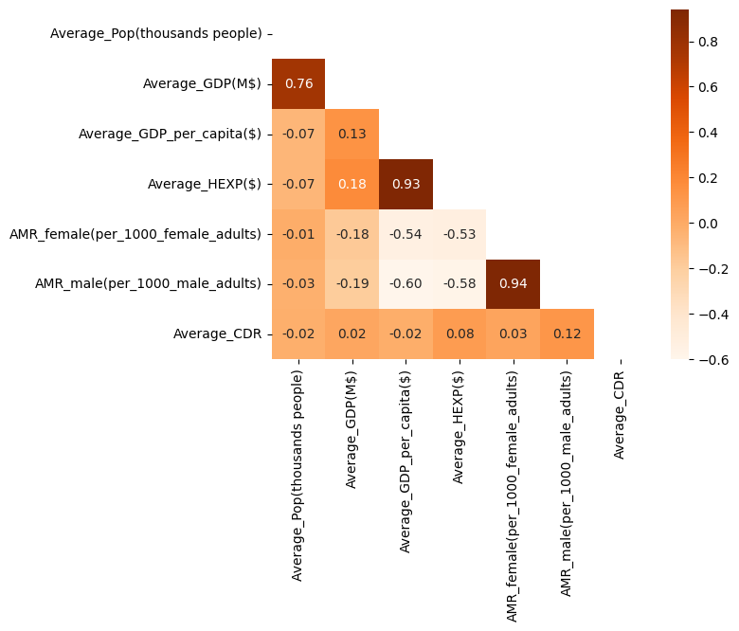
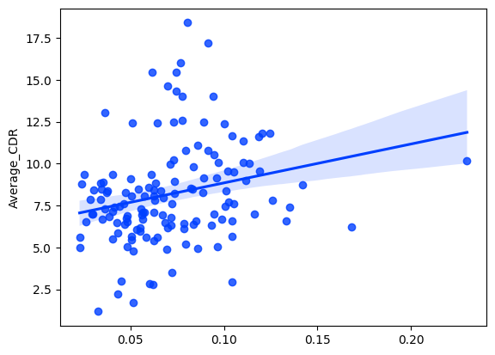
RESULT

Slide 10
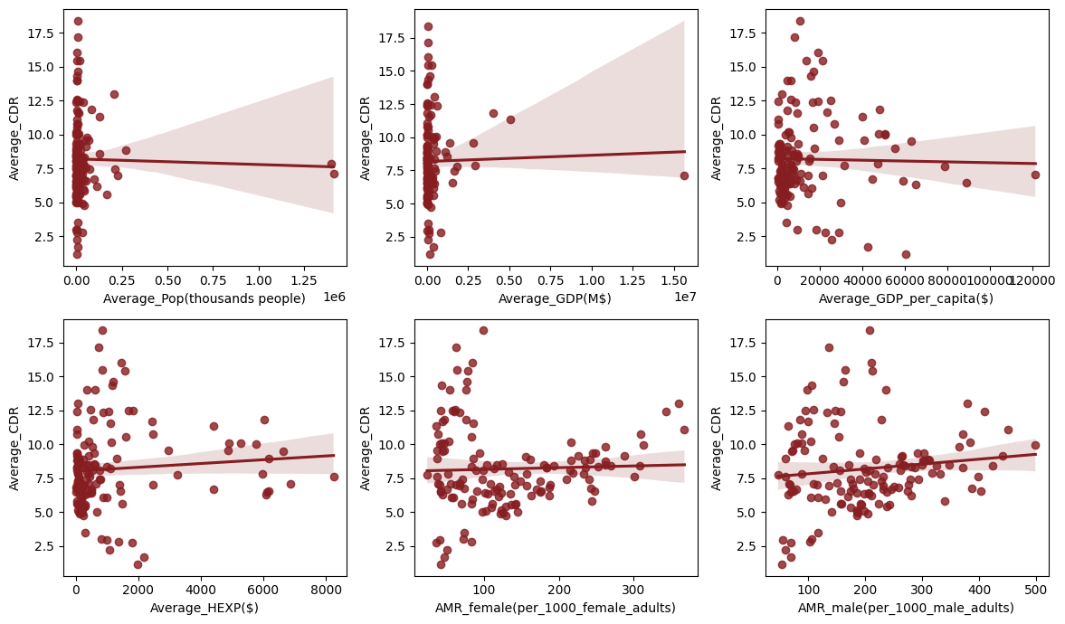

Slide 11
CONCLUSION
In conclusion, the deployment of the automated system for real-time analysis of adult mortality rates represents a significant step towards addressing public health challenges and reducing mortality disparities. By leveraging data-driven insights and evidence-based interventions, stakeholders can make informed decisions to improve population health outcomes. The deployed system provides a scalable, accessible, and secure platform for ongoing monitoring and evaluation of mortality trends, enabling timely interventions and policy adjustments. Through collaboration and continued efforts, we aim to enhance public health infrastructure, promote healthier lifestyles, and ultimately, mitigate the burden of adult mortality globally, fostering a healthier and more equitable society.

Slide 12
FUTURE SCOPE
The project's future scope includes expanding data sources for more comprehensive analysis, integrating advanced machine learning techniques for predictive modeling, and fostering international collaboration to address global mortality challenges. Additionally, incorporating real-time data streams and enhancing user interfaces for better accessibility and user engagement are potential avenues for improvement.

Slide 13
REFERENCES
https://www.kaggle.com
https://colab.research.google.com/?utm_source=scs-index

Slide 14
THANK YOU

